Slide 1
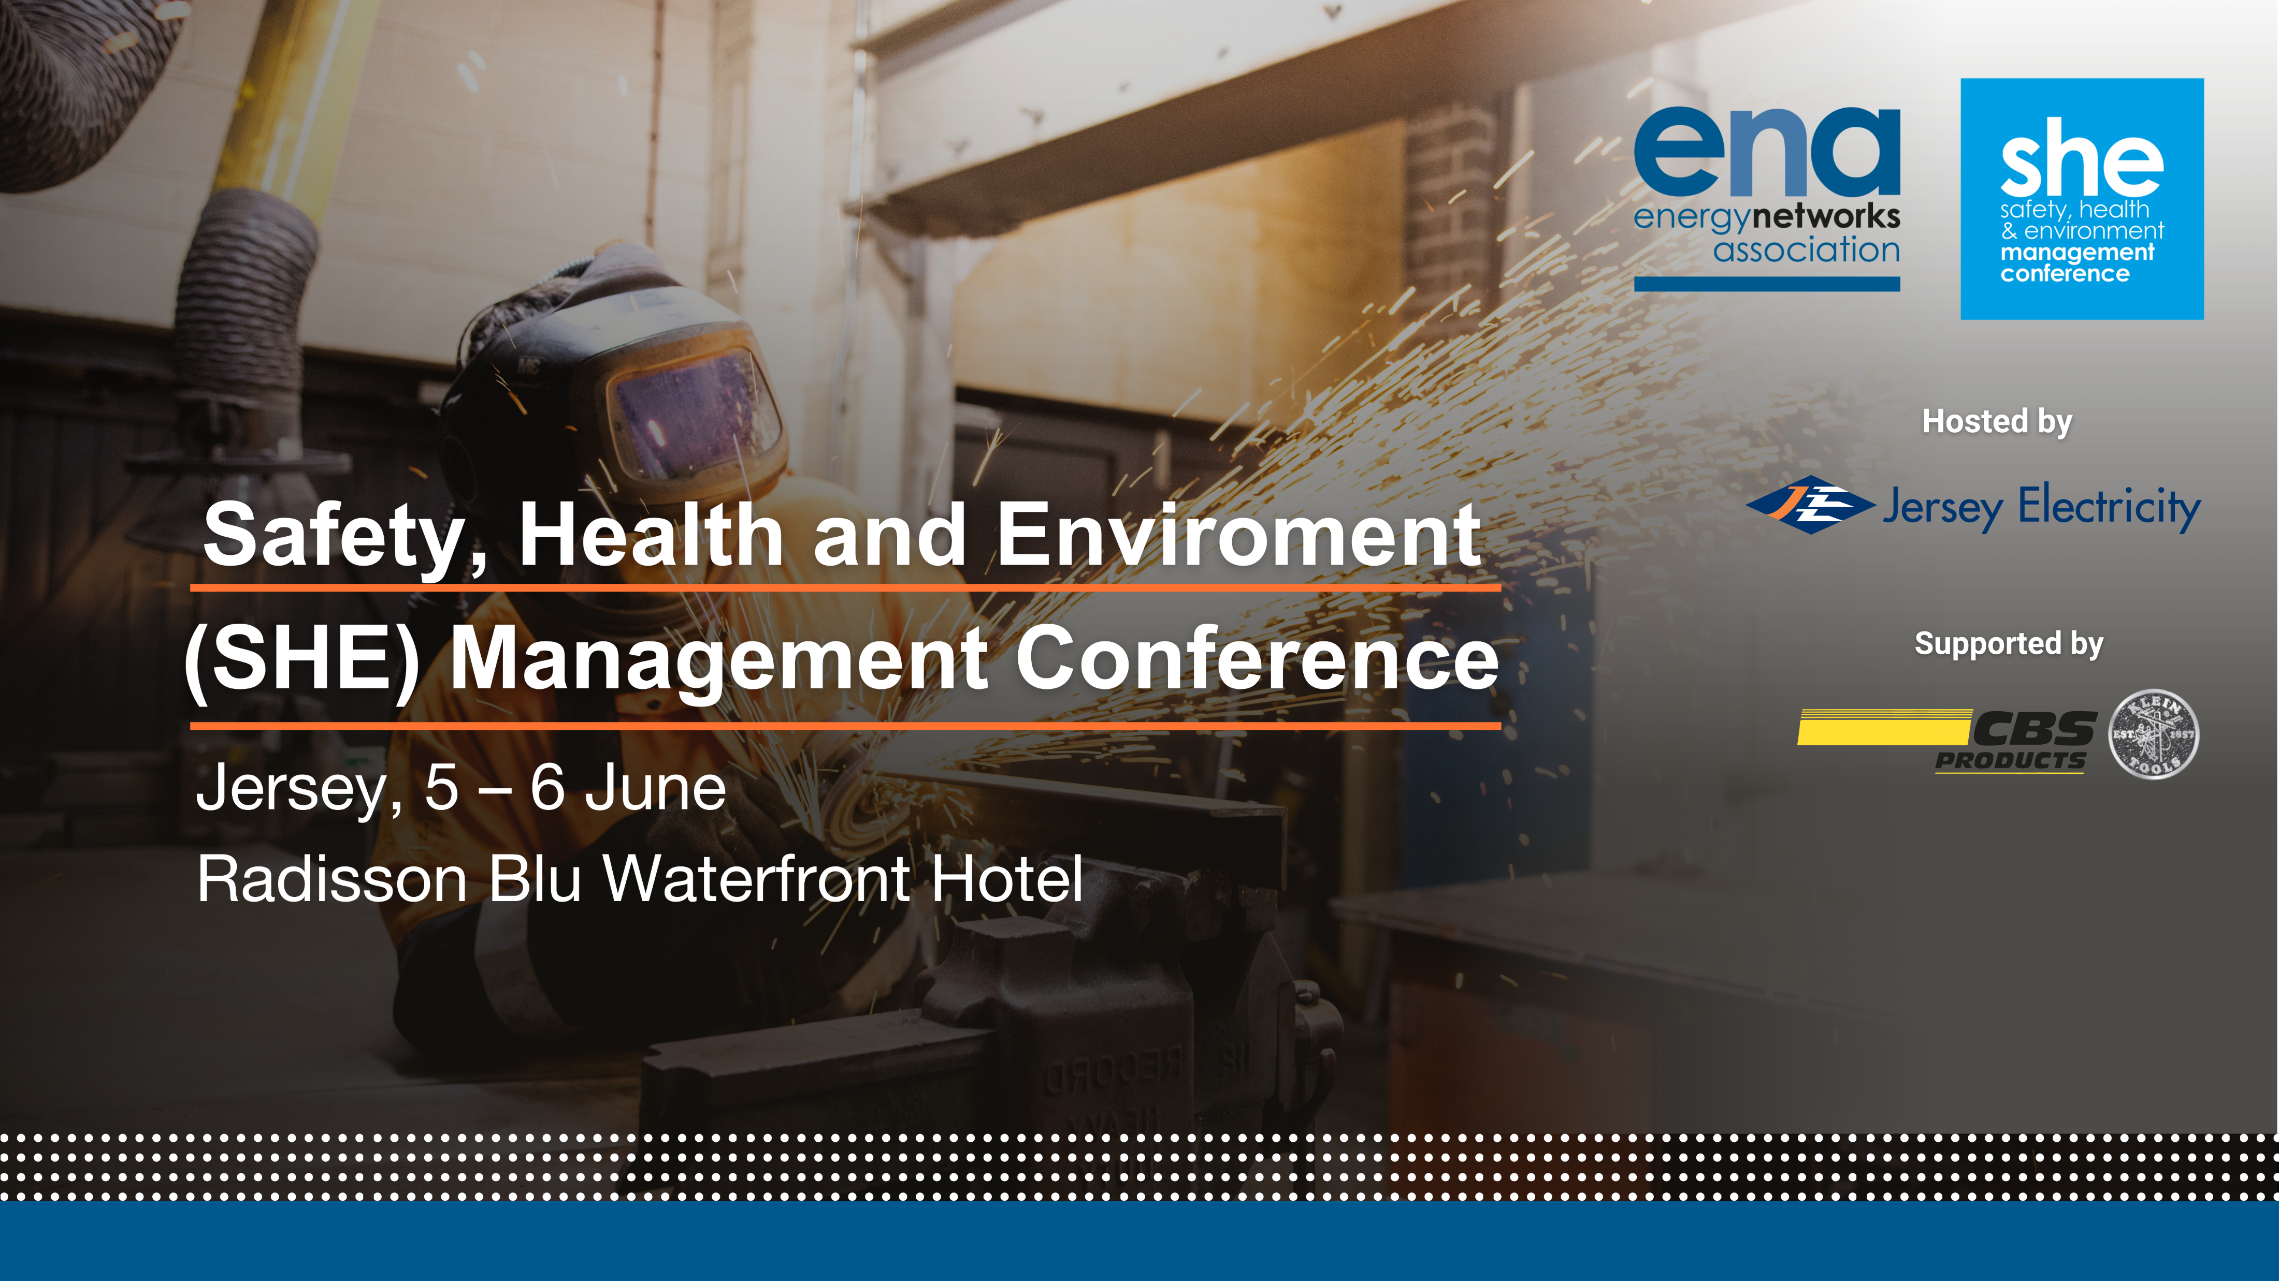
Session 3 –
Environmental sustainability

Slide 2








Squaring the Circle of
ESG
Keith Hole
CFIOSH FIIRSM EurOSHM PIEMA DipNebosh HNDip(N’bria) AIGEM BII
Chartered Business Risk and Safety & Sustainability Consultant
TSM UK Consulting Ltd. Registered Office: The Barn, RH13 6PT
Registered in England and Wales No: 11804490 Vat No. GB 417 8822 73
Email: Info@tsm.uk +44(0)7966405025 ©TheSafetyMan.UK 20240604

Slide 3






ESG Key Reporting
Elements:
Where are your biggest impacts?
E
S
G
Environmental
Social
Governance
Climate Change
Natural Resources
Pollution and Waste
Environmental opportunity
Human Capital
Product Liability
Stakeholder Opposition
Social opportunity
Corporate Governance
Corporate Behaviour
Contractor engagement
Carbon emissions
Water Stress
Waste and toxic emissions
Leading technology, clean tech
Workforce management
Product safety and quality
Controversial sourcing
Psychosocial risk
Board Diversity
Business Ethics
Contractor management
Carbon footprint (product)
Bio diversity and land use
Waste materials and packaging
Green construction and building
Health, Safety and Wellbeing
Chemical safety
Conflict materials
Access to occupational health
Executive Pay
Anti Competition
Sustainable contracts
Environmental impact cost
Raw materials
WEEE
Renewable energy
Sustainable workforce
Financial product safety
Rare Earth materials
Access to communication and consultation
Ownership
Probity and corruption
Shared values
Climate change vulnerability
Climate change vulnerability
GDPR and data security
Wellbeing
Accounting
Financial stability
Shared policies
Responsible investment
Sustainable recruitment
Responsible tax practices
TSM.UK

Slide 4





ANNEX L Read Across
 | ISO 9001 | ISO 14001 | ISO 45001 | ISO 45003 | ISO 50001
4: Context of the Organisation | 4.1 Understanding the context of the organisation 4.2 Understanding the needs and expectations of interested parties 4.3 Determining the scope of the management system 4.4 The Management system
5: Leadership | 5.1 Leadership and commitment 5.2 Policy 5.3 Organisational roles, responsibilities and authorities
6: Planning | 6.1 Actions to address risks and opportunities 6.2 Objectives and planning to achieve them
7: Support | 7.1 Resources 7.2 Competence 7.3 Awareness 7.4 Communication 7.5 Documented information
8: Operation | 8.1 Operational planning and control
9: Performance Evaluation | 9.1 Monitoring, measurement, analysis and evaluation 9.2 Internal audit 9.3 Management review
10: Improvement | 10.1 General 10.2 Nonconformity and corrective action 10.3 Continual improvement
TSM.UK

Slide 5

Placing Risk Management Before Objective Setting
Category | Threat / Opportunity | Risk / Aspect
Political | Opportunity | Changes in laws / policies
 |  | Work winning
 | Threat | Brexit
 |  | Conflict
Economic | Opportunity | Currency rate
 | Threat | Clients
 |  | Financial stability
 |  | Insurance
Social | Opportunity | Geographic location of projects
 | Threat | COVID19 and future pandemics
 |  | Injury to Member of the Public
Technical | Opportunity | Innovation
 |  | Quality Assurance
 | Threat | Design Errors
Environmental | Opportunity | Electricity use reduction
 |  | Solar power
 | Threat | CO2 emissions
 |  | Pollution incidents
 |  | Storage of chemicals
Legal | Opportunity | Certification
 | Threat | H&S
 |  | Prosecution
Risks
Mitigations
PESTLE
Objectives
Opportunities and Threats
TSM.UK

Slide 6

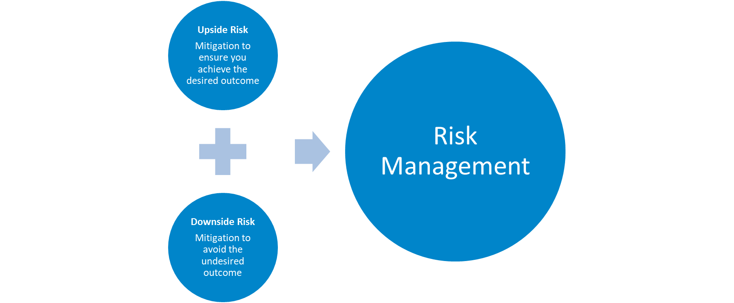
Upside and Downside Risk
TSM.UK

Slide 7

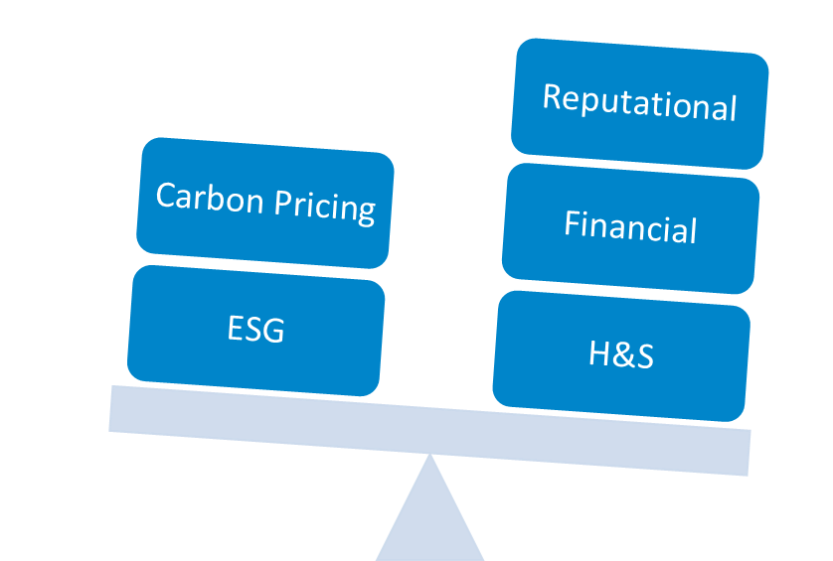
Where is your risk focus?
Health and Safety
ESG
Reputational
Financial
Carbon Pricing
TSM.UK

Slide 8
ESG Key Reporting
Elements:
Where are your biggest impacts?
E
S
G
Environmental
Social
Governance
Climate Change
Natural Resources
Pollution and Waste
Environmental opportunity
Human Capital
Product Liability
Stakeholder Opposition
Social opportunity
Corporate Governance
Corporate Behaviour
Contractor engagement
Carbon emissions
Water Stress
Waste and toxic emissions
Leading technology, clean tech
Workforce management
Product safety and quality
Controversial sourcing
Psychosocial risk
Board Diversity
Business Ethics
Contractor management
Carbon footprint (product)
Bio diversity and land use
Waste materials and packaging
Green construction and building
Health, Safety and Wellbeing
Chemical safety
Conflict materials
Access to occupational health
Executive Pay
Anti Competition
Sustainable contracts
Environmental impact cost
Raw materials
WEEE
Renewable energy
Sustainable workforce
Financial product safety
Rare Earth materials
Access to communication and consultation
Ownership
Probity and corruption
Shared values
Climate change vulnerability
Climate change vulnerability
GDPR and data security
Wellbeing
Accounting
Financial stability
Shared policies
Responsible investment
Sustainable recruitment
Responsible tax practices
TSM.UK

Slide 9







ESG Maturity
06
05
04
03
Excellence, Positive Industry Disruption
Increasing value for society and all stakeholders
02
Leadership, Strategic Investment
Sustainable business and procurement practices
01
Efficiency, Smart to do
Operational efficiencies and savings, set baselines and set environmental targets
Maturity level
Obligation, Expected or Pressured to do
Reduce reputational, operational and financial risk + voluntary ESG reporting
Strategy
Programmes
Operations
Data and measurement
Stakeholder engagement
Reporting
Compliance, Legally Required to do
Reduce operational and compliance risk + mandatory ESG reporting
Disregard, Ignore and Face the Consequences
Non compliance and operational failure
TSM.UK

Slide 10






ESG Roadmap
EFFICIENCY
LEADERSHIP
EXCELLENCE
Sustainability Manager
ISO 50001 Smart Waste
Implementation of energy targets
Impacts and opportunities plan
B-Corp
ISO 45003 Occupational Health and Safety Management
ESG reporting
Positive disruption of the industry
TSM.UK

Slide 11





4 Year Plan
2026
  Review of Benchmarks and objectives
  Publication of ESG report
  Review of 3-year cycle
  Reduction of plastics by 50%
  Review of supply chain strategy
2025
  Electrification of fleet and plant
  Investment in hydrogen
  Review of buildings and solar farming
  Diversity of leadership team
  Publication of ESG report
  Leading Employee engagement
2024
  B-Corp re-assessment and benchmarking
  Review of supply chain and Scope 1,2 and 3 emissions
  Setting of ESG objectives
Publication of ESG report
Procurement policy's updated taking into account chain of custody and CO2
2023
  Appointment of ESG Lead
  Code of Conduct to be signed by CEO and strategic supply chain partners
  Understanding of impacts and climate change, delivery of ESG briefing and climate sessions
  Initial benchmarking of CO2 emissions and setting of targets
  Achievement of ISO 50001
Publication of first ESG report detailing ESG policy and setting of benchmarks.
  ISO 45003 Psychosocial Risk
TSM.UK

Slide 12
;
TSM.UK

Slide 13
The Sustainability challenges
Paul Parkinson, Supply Chain School: 6th June 2024

Slide 14

Our vision is an industry where everyone will have the skills and knowledge to deliver a sustainable future.
Slido:
Who has heard of the Supply Chain Sustainability School?

Slide 15
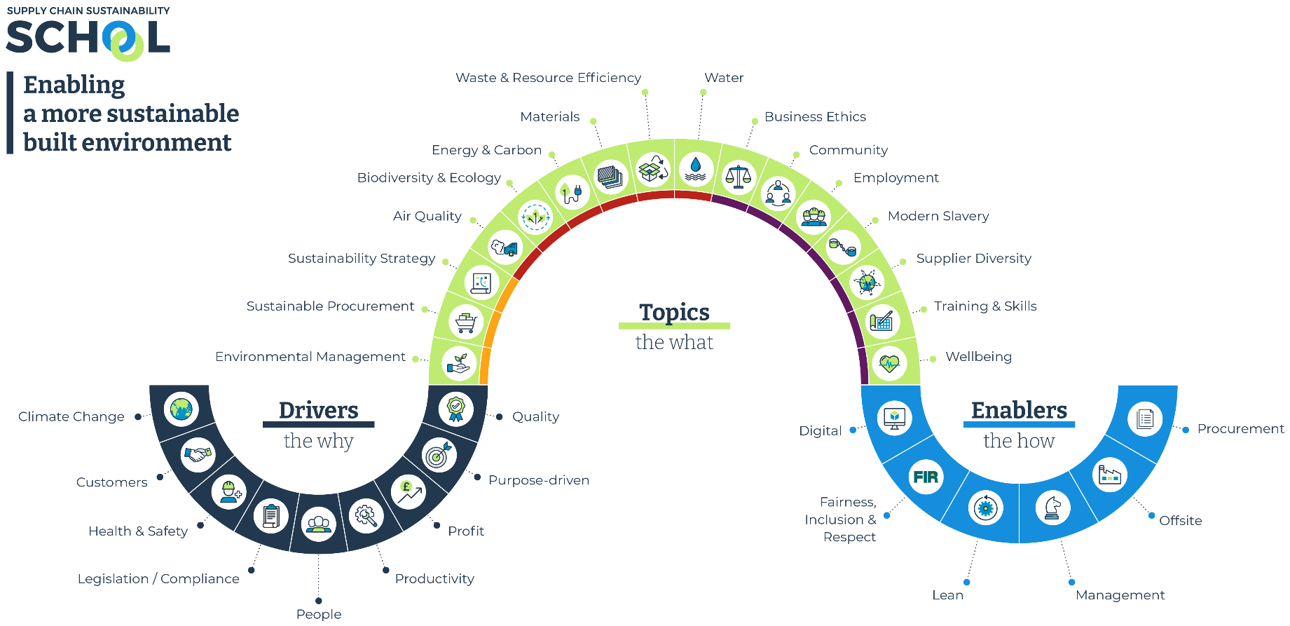
Notes:
I think we need ‘Innovation’ in the enablers

Slide 16
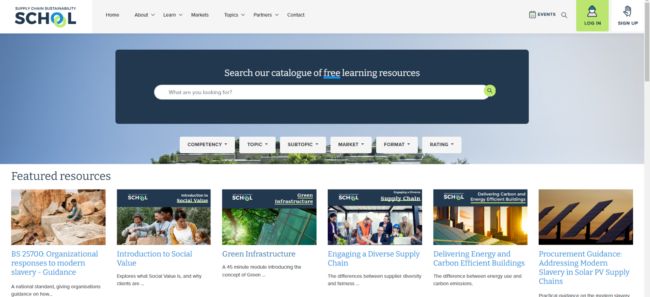
Over 4,000 learning resources
Free at the point of use!

Slide 17
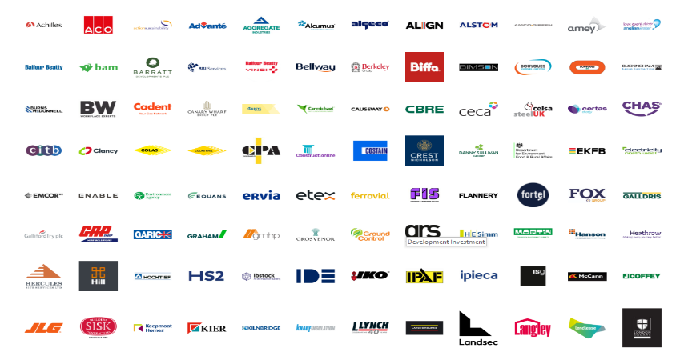




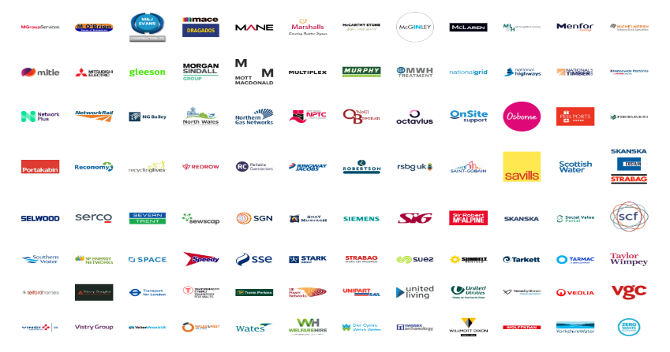


Collaborative Sustainable Development
Our platform is trusted by 230 major companies who have come together to collaborate in the UK to engage and then develop the knowledge and capability of their suppliers.
230
Partners
5,000
Suppliers
32
Conferences
100
Lunch & learns
11 years
400
Workshops
100,000
Resource views
24,500
People

Slide 18












Our Partners in your network

Slide 19
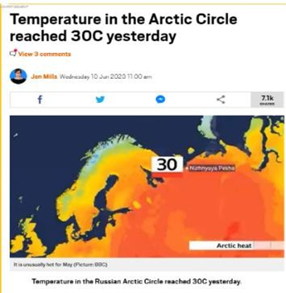

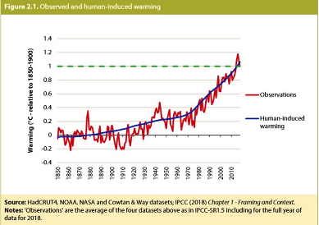
The common sustainability challenges
We all know what they are:
Carbon / Waste / Modern Slavery / Sus’ Procurement / MMC / Social Value and more……
      The keys are:
        Taking your workforce with you:
      Explain, educate, upskill
Engaging your supply chain:
Explain, educate, upskill, procurement leverage
        Measurement:
        Key metrics/indicators/upskill/embed
Key thoughts:
Don’t assume sustainability knowledge (workforce/supply chain)
Don’t assume knowledge of why we’re going in this direction (PPN06/Legislation)
Highlight the role of the individual/team/group in change making
Don’t assume knowledge of how?
Responsibility/accountability/procurement leverage

Slide 20

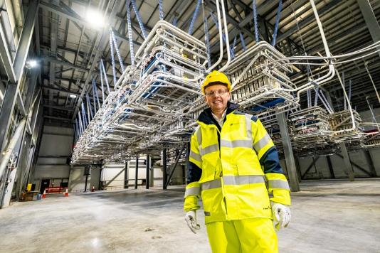
Case study: SSE
Workforce engagement:
506 individual staff members enrolled in the School
SSE have achieved 844 hours of total learning hours using the School’s resources
444 hours of CPD accredited training
SSE staff have attended 158 separate training events
SSE are classed as a “Gold” member of the School thanks to their regular engagement
5 Climate Academy sessions: On average 2,000 employees at these training workshops
Energy Customer Services: Climate change and carbon reduction workshops for workforce – helping them to engage with domestic and commercial customers.

Slide 21

Case study: SSE Supply Chain
How to upskill:
6 training sessions focusing on climate change for the supply chain – vital to help them to understand your drivers and what is expected.
Guidant Training Session – November 2023
Social Value Roundtable Training Session – May 2023
Supplier Day - September 2023
Supply Chain Climate Academy – 2022
Priority suppliers in the School: 370
Provision of on-line training and workshops through the School to the supply chain – The supply chain has achieved:
9,808 e-learning modules completed
2,958 CPD accredited hours of e-learning
16,509 total hours of training received
202 individuals from SSE supplier base have attended a School training session

Slide 22
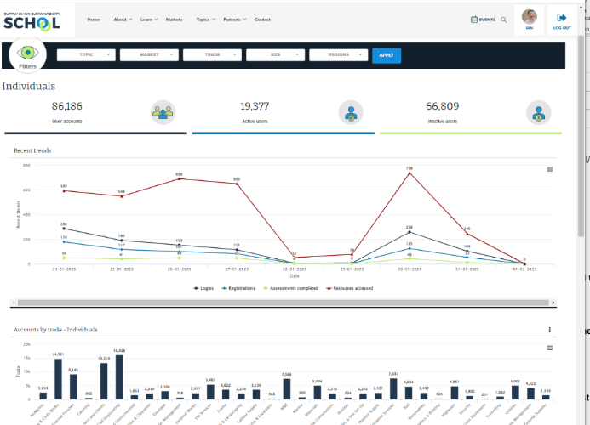
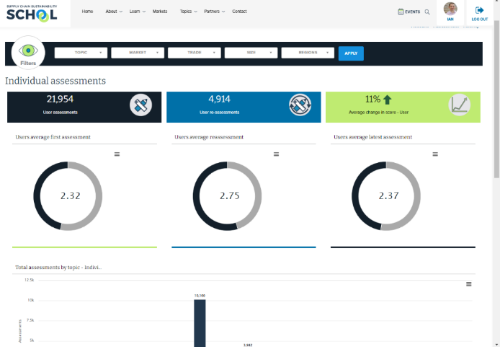
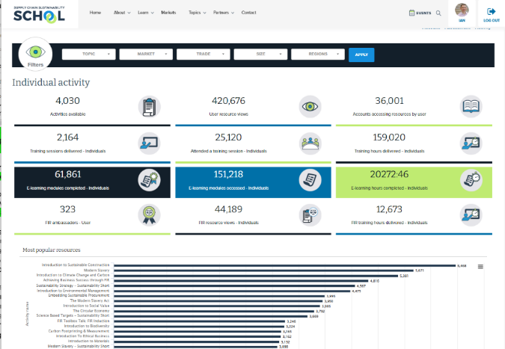
Measurement:
Data Reporting Dashboards
Engagement
Assessment
Activity

Slide 23



Case study: SSE Measurement
Measuring and managing your supply chains’ sustainability outputs is vital.
  Regulatory challenges
  Large organisations are under increasing pressure from sustainability initiatives (local, regional and international) to measure, communicate and improve performance
  Client / Govt’ pressures/ Stakeholder
  Client organisations are increasingly demanding more evidence of commitment to sustainability and of ongoing sustainability initiatives
  Supplier Support
  Suppliers need increasing support to measure and report their sustainability outputs and lack the mechanisms to do so effectively, passing the risk onto you

Slide 24
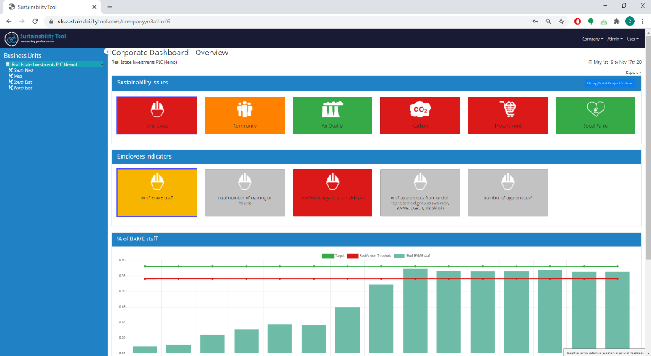
Case study: SSE Supply Chain
SSE is collecting key sustainability data across 3 divisions:
Benefits:
A more knowledgeable supply chain who understand the why
Help and support for suppliers to input data – educate
One ‘ask’ for the supply chain – less time consuming
A single source of truth for the client
Real time management of under-performance
NO speadsheets!!!!

Slide 25
Measuring and managing
Identify a reporting platform to manage and analyse performance against your sustainability strategy
Provide ‘how to’ guidance
Highlight why you need it
Embed in procurement.
If you’re not already:
Work together on the ‘ask’ for the supply chain.
Make it easier for them and, ultimately, get better data
Adapt it to your sustainability strategy across all your priority areas and KPIs
Gather granular data deep into your organisation, client projects and supply chain
Provides real-time verifiable data
Maximises sustainability benefits & minimises risks through shared accountability

Slide 26
Thank you
Paul@supplychainschool.co.uk

Slide 27


